Slide 1
Hi everyone,
In previous presentations we have covered simple
concepts of Photosynthesis and Transpiration. Ascent of sap,
Cell division and Genetics will be done in our regular classes.
You will complete your written work for previous chapters during
coming week. Till then we will start with some easy topics
from Circulatory system. I have selected this chapter as you have
learnt some concepts in Std-8.
First three pages are easy to understand.

Slide 2
Self study topics:
8.1 Need for transport inside the body.
8.2 Fluids in our body.
8.3 Properties of blood.
8.4 Functions of blood.
The points not understood will be covered in the class.
Compounds of haemoglobin-
Haemoglobin forms unstable compound with oxygen ‘oxy-haemoglobin’.
It also forms unstable compound with carbon dioxide ‘carbamino-haemoglobin’.
Being unstable oxygen and carbon dioxide both can get easily detached during
gaseous exchange in the alveoli. Haemoglobin, combines with carbon monoxide to form stable compound ‘carboxy-haemoglobin’. Carbon monoxide remains
attached to haemoglobin and reduces its capacity to carry oxygen. This is known as carbon monoxide poisoning which leads to death, sometimes.

Slide 3
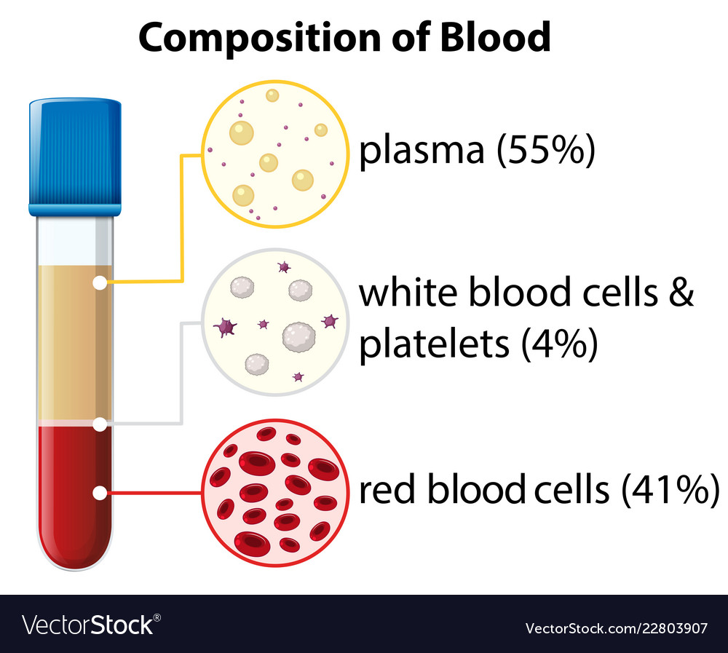
Plasma-Light yellow coloured fluid 55-60% of blood. It is made up of Water, proteins, inorganic salts like sodium chloride and sodium Bicarbonate, other substances in the blood are glucose, fibrinogen, amino acids, hormones and urea, etc. The plasma from
which the protein fibrinogen has been removed is called serum.

Slide 4
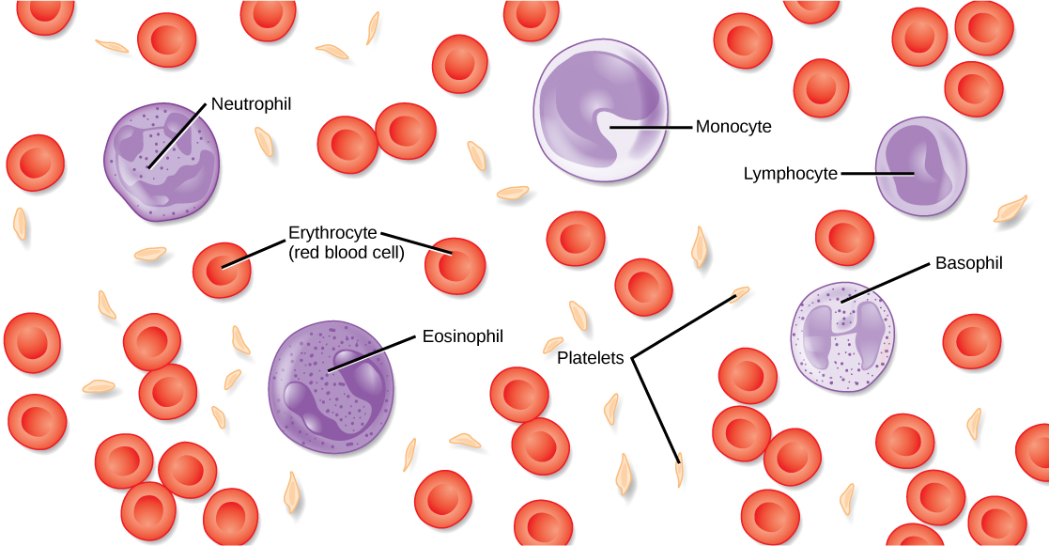
Cellular Elements
The blood smear- A drop of blood is spread on the glass slide and stained with Leishman stain. When observed under the microscope shows formed elements of the blood erythrocytes, leucocyte sand platelets.

Slide 5
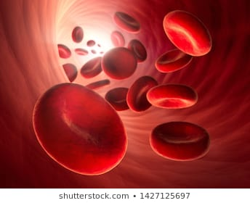
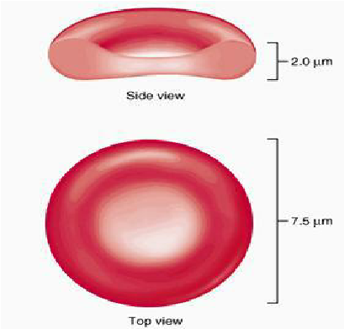
Erythrocytes-Red blood corpuscles.
Erythrocytes are minute, 7 micron in size, biconcave discs, flat in the center ,thick and rounded at the periphery.
Erythrocytes are deficient but efficient. How ?
No nucleus-makes red blood cells biconcave, increasing surface area volume ratio for absorbing more oxygen as space in between is increased accommodating more red blood cells in same place.
No mitochondria-red blood cells cannot use oxygen for themselves as cellular respiration occurs in mitochondria. All oxygen is transported to cells and glucose in blood plasma remains unutilized.
No endoplasmic reticulum-flexibility of red blood cells increases and allows easy movement through narrow capillaries.

Slide 6
Self study Topics-
Life and death of erythrocytes Page 93
More about the number of erythrocytes .Page 94
Scientifically erythrocytes are not cells but corpuscles. Why? Because they do
not fulfil the definition of the cell. They do not have nucleus, when they are
produced they have one. As they mature ,the nuclei are lost, they are
Enucleated.
Anyway, we can use red blood cells as text book also says so!
Waiting for homework? No dear students, not this time! Enjoy………..
But….Do not forget to complete previous exercises……….

